Slide 1
Welcome to the 2013
This webinar is presented by Keith Klain and he will discuss:
‘The Confidence Game
- What is the Mission of Testing?’
This webinar is due to start at 3:40PM. Make sure you stick around at the end for the Q&A session and continue the conversation with the speaker on Twitter after the show!
Join the conversation on Twitter!
@esconfs #esconfs

Slide 2
@esconfs
#esconfs

Slide 3
skepticism
the doctrine that true knowledge or knowledge in a particular area is uncertain
@esconfs
#esconfs

Slide 4
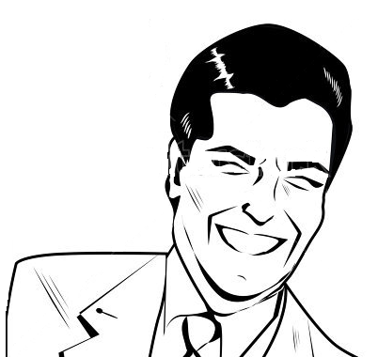
“confidence can be established across a multi-dimensional framework!”
“coverage metrics can measure confidence!”
@esconfs
#esconfs

Slide 5
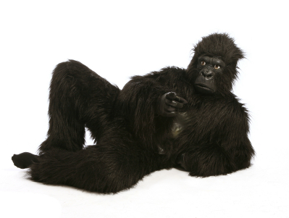
marketing
@esconfs
#esconfs

Slide 6
confidence in…
TESTING
products and systems
DECISIONS
COVERAGE
@esconfs
#esconfs

Slide 7
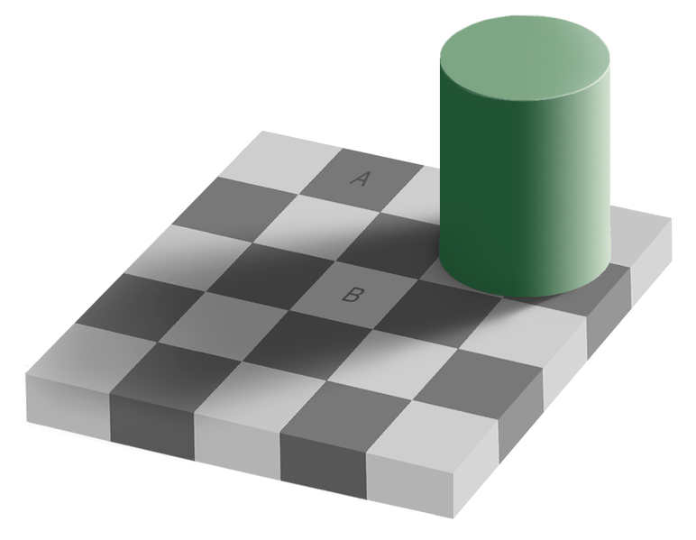
@esconfs
#esconfs

Slide 8
@esconfs
#esconfs

Slide 9
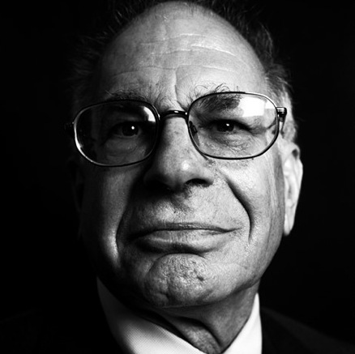
”Overconfident professionals sincerely believe they have expertise, act as experts and look like experts. You will have to struggle to remind yourself they may be in the grip of an illusion.”
Daniel Kahneman
@esconfs
#esconfs

Slide 10
i
confidence
@esconfs
#esconfs

Slide 11
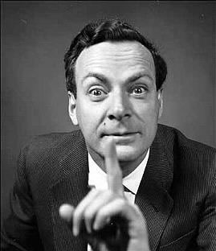
“We never are right, we can only be sure we are wrong.”
Richard Feynman
@esconfs
#esconfs

Slide 12
what is the
mission
of testing?
@esconfs
#esconfs

Slide 13
nformation!
@esconfs
#esconfs

Slide 14
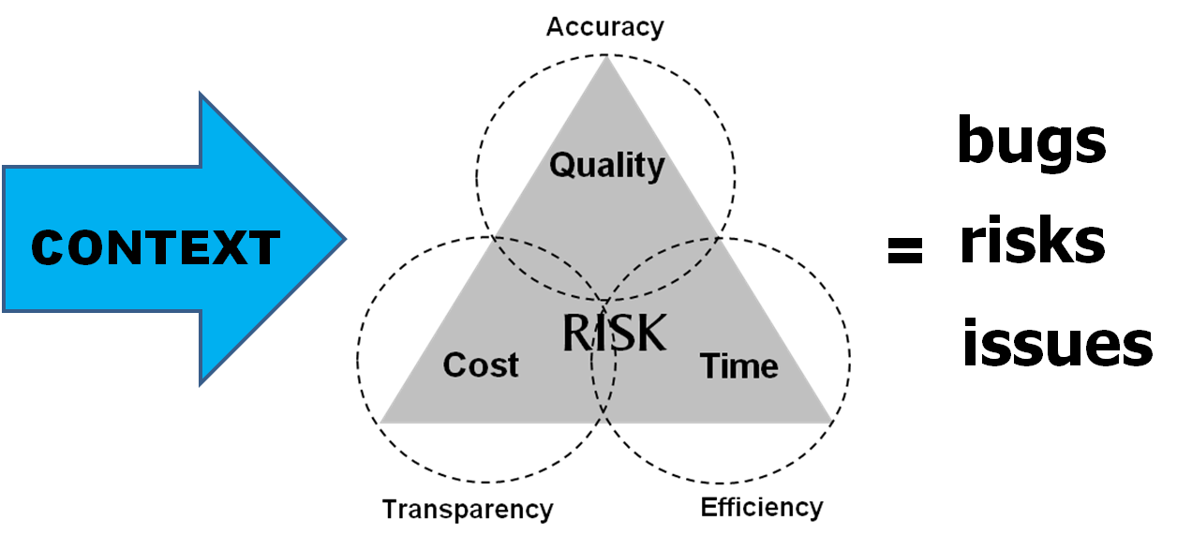
“testing is QUESTIONING a system in order to evaluate it.” James Bach
@esconfs
#esconfs

Slide 15
@esconfs
#esconfs

Slide 16
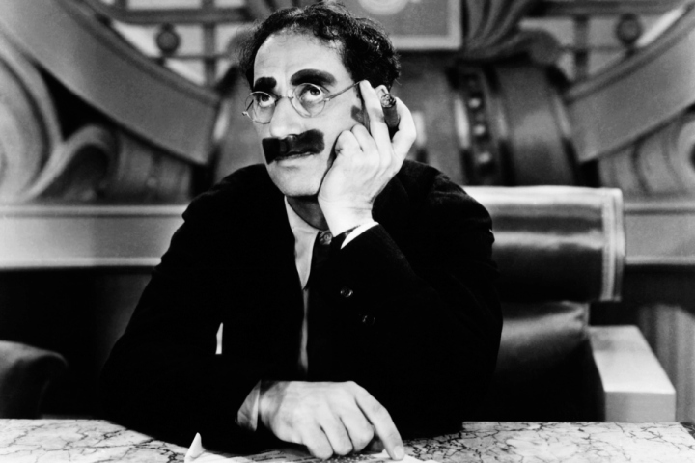
“Politics is the art of looking for trouble, finding it everywhere, diagnosing it incorrectly and applying the wrong remedies.”
Groucho Marx
@esconfs
#esconfs

Slide 17
confidence
@esconfs
#esconfs

Slide 18
MANAGE
YOUR
OWN
EXPECTATIONS!
@esconfs
#esconfs

Slide 19
Thank you!
http://qualityremarks.com
@keithklain
@esconfs
#esconfs

Slide 20
Thanks for listening!
Please type your questions for the speaker into the box provided.
Don’t miss Keith Klain Keynote Talk: “Creating Dissonance: Overcoming Organizational Bias Toward Software Testing at the 2013 EuroSTAR Conference.
Go to www.eurostarconferences.com for more information
@esconfs
#esconfs

